Slide 1

Albemarle Regional Hazard Mitigation Plan Background and Adoption Procedure

Slide 2
Building the Plan:
Meetings Occurred to Date
Project Kick-off in Currituck – May 11, 2014
Additional Advisory Committee Meetings through winter 2015
Publicly Advertised Meetings per requirements (2): Oct 22, 2014 and Jan 15, 2015 both occurring in Currituck Co.
Draft plan approved by FEMA – May 12, 2015
Locally adopt plan to complete process

Slide 3
What is Hazard Mitigation?
Mitigate: means to cause to become less harsh or hostile; to make less severe or painful
Hazard Mitigation: FEMA defines Hazard Mitigation as any sustained action taken to reduce or eliminate the long term risk to human life and property from hazards

Slide 4
What is Hazard Mitigation?
Local Gov’t Responsibility: To protect the health, safety, and welfare of their citizens. Proactive mitigation policies and actions help reduce risk and create safer, more disaster-resilient communities.
Mitigation is an investment in your community’s future safety and sustainability. Consider the critical importance of mitigation to:
Protect public safety and prevent loss of life and injury.
Reduce harm to existing and future development.
Prevent damage to a community’s unique economic, cultural, and environmental assets.

Slide 5
Regional Planning
A Regional Hazard Mitigation plan integrates the plans of several counties and municipalities into a single plan. Jurisdictions work together in the planning process to develop a mitigation strategy based on their risk to similar hazards, saving time and resources and making the plan easier.

Slide 6
Regional Planning
Benefits of a Regional Hazard Mitigation Plan
1. Shared Resources - Less money is needed by individual governments to update the plan. Local municipalities' planning departments share in the work, thus improving efficiency. Also, municipalities can share in the cost of the local match when applying for projects. For instance, instead of having to produce 25% match (PDM), local governments can share cost with neighboring partner.

Slide 7
Regional Planning
Benefits Cont’d.
2. Regional plans receive priority for planning grant funds - NCEM recognizes that regional plans can be more cost beneficial. Those applicants will have a better chance of receiving a planning grant.
3. No local control is compromised or lost - As a participating municipality in a FEMA approved and adopted regional plan, all participants have the right to apply to NCEM for FEMA funding.

Slide 8
Disaster Mitigation Act of 2000
The purpose of the Stafford Act, as amended by the Disaster Mitigation Act of 2000, is “to reduce the loss of life and property, human suffering, economic disruption, and disaster assistance costs resulting from natural disasters.”
Section 322 of the Act specifically addresses mitigation planning and requires state and local governments to prepare multi-hazard mitigation plans as a precondition for receiving FEMA mitigation project grants.

Slide 9
Disaster Mitigation Act of 2000
Eligibility for Federal Grant Funds
Hazard Mitigation Grant Program (HMGP)
Flood Mitigation Assistance (FMA)
Pre-Disaster Mitigation (PDM)
NC Senate Bill 300
This amendment to the NC Emergency Management Act became law in June 2001. Local Hazard Mitigation Plans are required for Public Assistance (PA) for state declared disasters

Slide 10
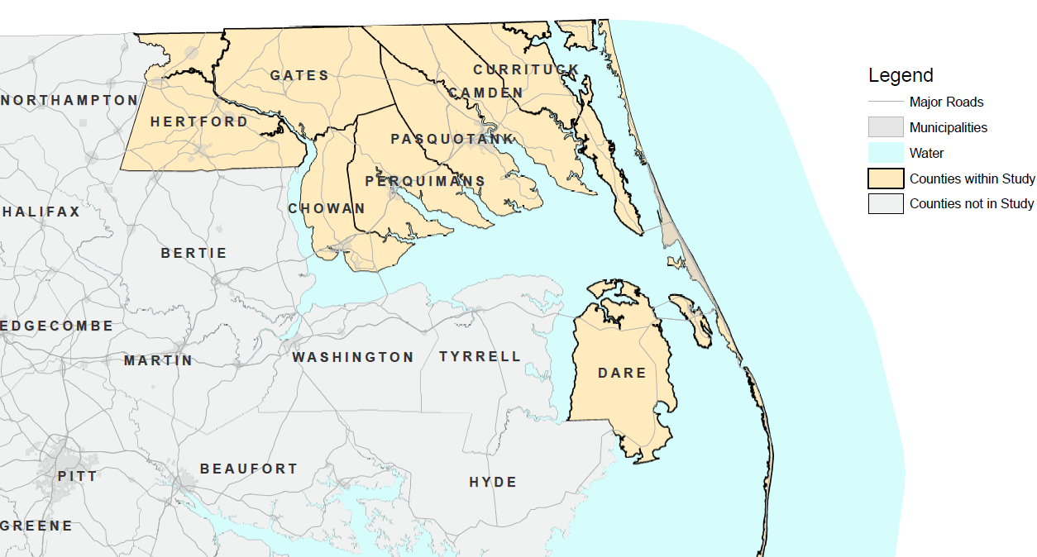
Albemarle Region

Slide 11
Jurisdictions
Camden County | Chowan County | Currituck County | Dare County | Gates County | Hertford County | Pasquotank County | Perquimans County
 | Town of Edenton |  | Town of Duck | Town of Gatesville | Town of Ahoskie | Elizabeth City | Town of Hertford
 |  |  | Town of Kill Devil Hills |  | Town of Cofield |  | Town of Winfall
 |  |  | Town of Kitty Hawk |  | Town of Como
 |  |  | Town of Manteo |  | Town of Harrellsville
 |  |  | Town of Nags Head |  | Town of Murfreesboro
 |  |  | Town of Southern Shores |  | Town of Winton

Slide 12
Project Overview
Purpose
To prepare a Regional Hazard Mitigation Plan for the Albemarle area in accordance with guidelines set forth by NCEM and FEMA, including but not limited to, NC Senate Bill 300, the Disaster Mitigation Act of 2000, NC Emergency Management Act, NCEM Local Hazard Mitigation Plan Update Checklist, FEMA Local Multi-Hazard Mitigation Planning Guidance and 44 CFR 201.6. The process will also follow the Community Rating System (CRS) 10–step planning process as required for communities participating in the CRS

Slide 13
Hazards Addressed
  Hurricanes
  Floods
  Tornados
  Winter Storms
  Severe Thunderstorm
  Wildfires
  Erosion
  Nor'easters
  Drought/Heat Wave
  Severe Winter Storms
  Volcanos
  Earthquakes
  Storm Surge
  Landslides/Sinkholes
  Dam/Levee Failure
  Tsunamis
  Rip Currents
  Terrorism
  Pandemic
  Transportation
  Haz Mat Incidents
  Nuclear Incidents
  Groundwater contamination
  Infectious disease

Slide 14
Project Overview
Key Objectives (Mitigation Techniques)
Prevention
Planning & Zoning, Building Codes, Open Space Preservation, Floodplain Regulations, Stormwater Management, Drainage System Maintenance, CIP
Property Protection
Acquisition, Relocation, Elevation, Critical Facilities protection, Retrofitting, Insurance
Natural Resource Protection
Floodplain protection, Watershed Management, CAMA, Riparian Buffers, Erosion/Sediment Control, Wetland preservation

Slide 15
Project Overview
Key Objectives (Mitigation Techniques)
Structural Projects
Floodwalls, Stormwater systems, Detention areas
Emergency Services
Warning systems, Shelter operations, Evacuation Planning, Emergency Response training
Public Education
Outreach projects, Hazard Map information, Real Estate Disclousre, School programs

Slide 16
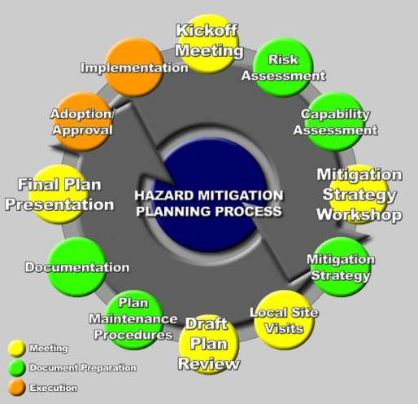
Planning Process

Slide 17
Project Overview
Project Task (Plan Sections)
Planning Process
  Project Kickoff
  Develop Outreach Strategy
  Facilitate Regional Planning Team meetings
  Conduct Outreach
  Document the Planning Process

Slide 18
Project Overview
Project Task (Plan Sections)
Risk Assessment
  Data Collection/Analysis
  Hazard Identification
  Hazard Profiles & Mapping
  Inventory of Community Assets
  Vulnerability Assessment
  Findings and Conclusions

Slide 19
Project Overview
Project Task (Plan Sections)
Capabilities Assessment
  Review Existing Capabilities
  Findings and Conclusions
Mitigation Strategy
  Update Goals and Objectives
  Analyze Actions and Projects
  Prepare Mitigation Action Plans
  Complete Action Prioritization

Slide 20
Project Overview
Project Task (Plan Sections)
Plan Maintenance Procedures
  Plan Implementation
  Plan Review and Update
  Continued Public Involvement

Slide 21
Project Overview
Project Staffing
Gates County – Lead Agency/Grants Management
The Wooten Company – Project Management/Plan Development
Participating Jurisdictions – Serve as members of the Planning Team; facilitate good communication throughout the project; engage public stakeholders; Stay involved

Slide 22
Data Collection
GIS Data Inventory
Good Local data is key for Risk Assessment
Capabilities Assessment Survey
What regulations/processes do jurisdictions have in place; what are their capabilities
Existing Mitigation Actions
Review existing actions to see which still apply and determine any new actions

Slide 23
Data Collection
Public Participation Survey
Gives the public an opportunity to provide input and participate in the planning process
A link to the survey can be posted on County/Town websites.

Slide 24
Roles & Responsibilities
Lead Agency
Gates County - Mr. Billy Winn
Grant Management/Project Management
Central point of contact for the project
Communication and coordination with participating jurisdictions, NCEM and FEMA

Slide 25
Roles & Responsibilities
The Wooten Company
Provide Technical Assistance including Planning guidance and insuring State and Federal Compliance
Conduct Risk Assessments, Capability Assessments
Summarize all results and report findings
Facilitate meetings, workshops, public meetings
Plan Preparation

Slide 26
Roles & Responsibilities
Designated Community Leads
Actively participate in the planning process by facilitating data collection and exchange, engaging stakeholders and the public, arrange and host planning team meetings, develop mitigation strategies, and provide plan review and feedback
Guide plans through the adoption process at the local level

Slide 27
Roles & Responsibilities
Participating Jurisdictions
Actively participate in the planning process by facilitating data collection and exchange, engaging stakeholders and the public, attend planning team meetings, develop mitigation strategies, and provide plan review and feedback
Guide plans through the adoption process at the local level

Slide 28
Adoption Procedure
Communities must hold a public meeting prior to adoption (community may use their Co. Commission/Town Board meeting as a public meeting)
  Meeting should be advertised according to a local public meeting process (10 days)
  The plan can be adopted immediately following the public meeting.
Adoption Resolutions are sent to NCEM by email or hard copy.

Slide 29
Adoption Procedure
NCEM forwards the Adoption Resolution to FEMA.
FEMA in-turn sends an “Approval” letter to NCEM who then forwards the letter to the consultant team and Lead County for dissemination to all communities participating in the plan. The letter will list any communities who have adopted and provides a new (5) five year expiration date for the plan (Note all communities have the same regional plan expiration date regardless of their respective adoption resolution date)

Slide 30
Adoption Procedure
Once all adoption resolutions have been recorded with FEMA, a final version of the plan MUST be submitted to NCEM. The final version of the plan incorporates all adoption resolutions and documentation that a final public meeting was held prior to adoption.

